Slide 1
Python installation and execution
By group f -
Kaviya priya
Poojitha
Ranjitha
roshini

Slide 2
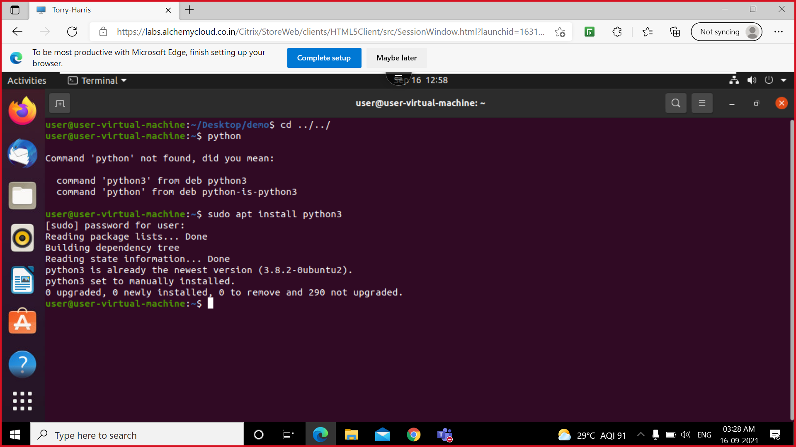
Installation
sudo apt install : this command is used to download the latest versions of our desired application from repository
apt –get command is responsible for installation, removal and updating of software in our system

Slide 3
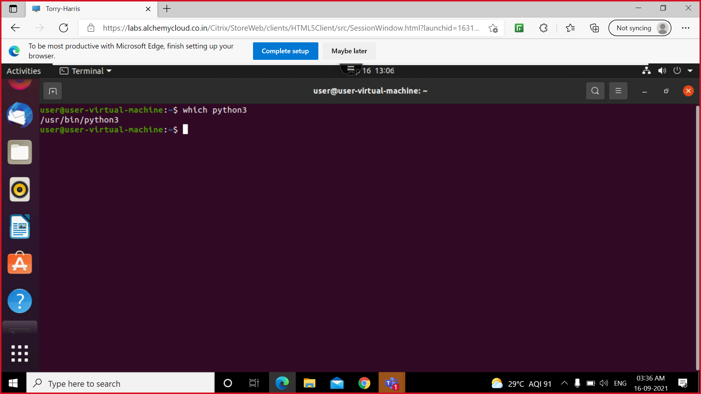
Which python3
This command is used to search the path of the file
/user/bin/python3

Slide 4
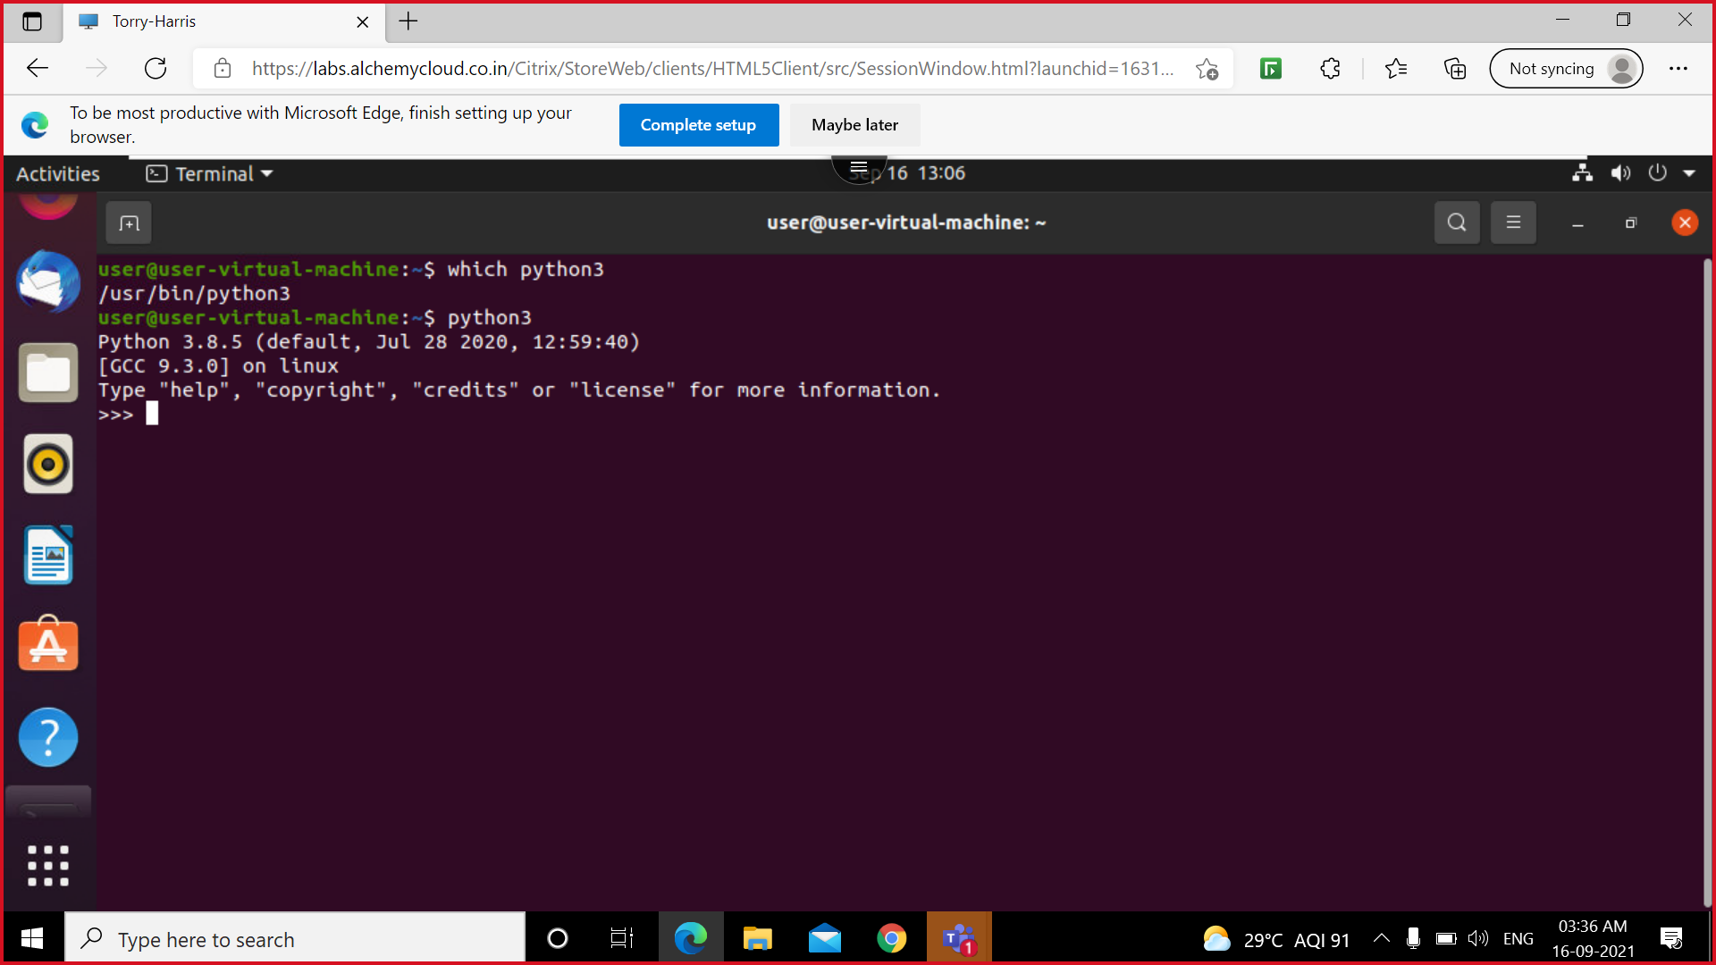
Working with python3
This command displays the description and launches the python3 interpreter

Slide 5

Code execution

Slide 6
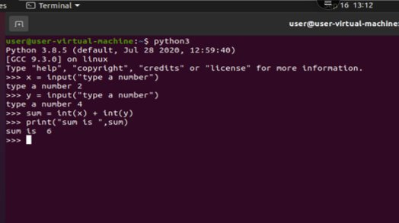
Code execution

Slide 7
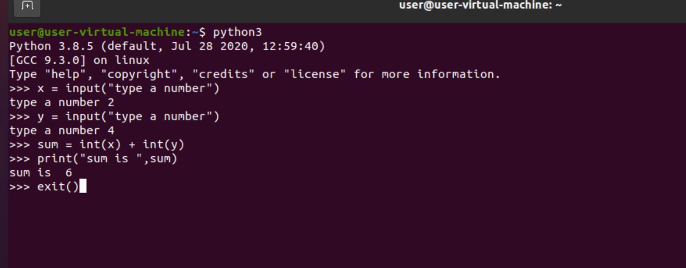

Slide 8
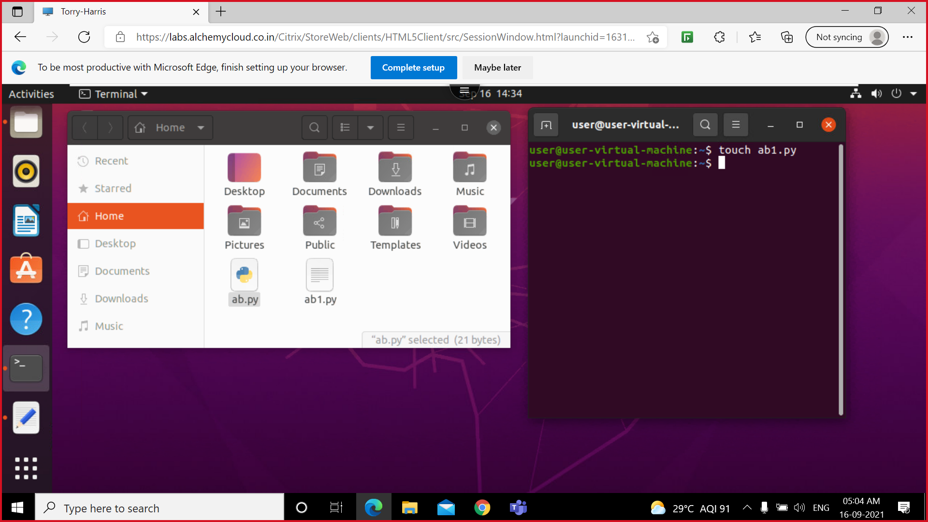
Other way of execution

Slide 9
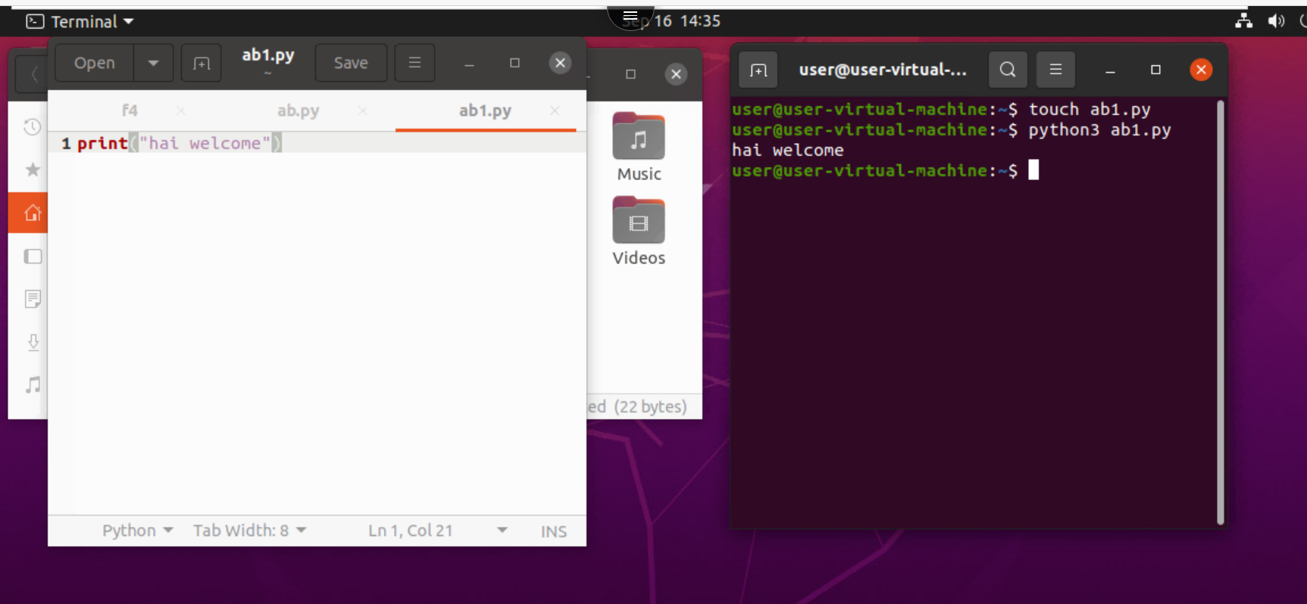
Output of code

